Slide 1


Reward Management (Chapter 8)
Suraj Bhattarai
015BIM061

Slide 2
Reward
Reward Management
the total return given by an employer to an employee for rendering his/her services towards the organizational objectives
primary objective of organizations in giving rewards is to
attract
maintain and retain efficient
high performing
motivated employees

Slide 3
Reward Management
Types
Intrinsic
Extrinsic
Note: Another word to extrinsic and intrinsic is Financial and Non-financial some texts also refer to them as monetary and non-monetary.

Slide 4
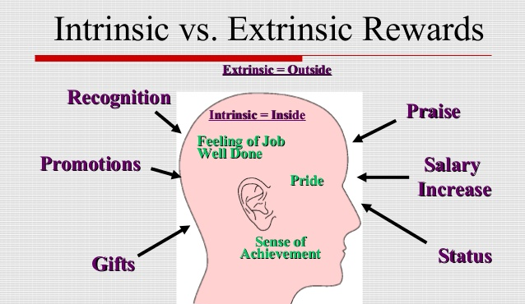
Types
Reward Management

Slide 5
1. Intrinsic Rewards
Reward Management
intrinsic rewards are intangible rewards internalized by individual employees as a result of their participation in specified activities
It includes,
Achievement,
feeling of accomplishment,
recognition, job satisfaction,
personal growth and status,
job enlargement,
job enrichment,
team working,
Empowerment etc

Slide 6
2. Extrinsic Reward
Reward Management
Extrinsic rewards are the tangible rewards in form of pay and benefits
It includes,
base wage or salary,
incentive payments,
fringe benefits,
promotion,
social relationship and work environment etc

Slide 7
Qualities of effective rewards
Reward Management
An effective reward management system is essential for high satisfaction and motivation of employees at work
effective reward system should possess the following qualities,
Importance
Equitable
Visibility
Flexibility
Low Cost

Slide 8

Employee Benefits
Reward Management
Employee benefits and benefits in kind include various types of non-wage compensation provided to employees in addition to their normal wages or salaries.

Slide 9
Types of employee benefits
Reward Management
Bonus Options for Employee Benefits
Performance bonus, attendance bonus etc
Medical and Health for Employee Benefits
Medical care programs, fitness facility memberships etc
Paid Time Off for Employee Benefits
Sick leave, vacation etc

Slide 10
Types of employee benefits
Reward Management
Insurance Benefits for Employees
Life insurance, short-term/long term disability insurance etc
Retirement Benefits for Employees
Defined benefit pension, profit sharing etc
Children and Family for Employee Benefits
Free child care, free elder care etc

Slide 11
Types of employee benefits
Reward Management
Employee Benefits Related to Pets
Dog and cat grooming, pet insurance etc
Education and Development for Employee Benefits
Career planning and development, loan for children education etc
Food as Employee Benefits
Free lunch, free drinks etc

Slide 12
Types of employee benefits
Reward Management
Other benefits,
Clothes as Employee Benefits,
Personal Care Employee Benefits,
Discounts for Employees as Benefits,
Transit Employee Benefits etc

Slide 13
References
Reward Management
The Concept And Definition Of Reward Management Essay, https://www.ukessays.com/essays/management/the-concept-and-definition-of-reward-management-essay.php
Employee benefits, http://hrmpractice.com/types-of-employee-benefits-2/
Reward, https://www.mbaskool.com/business-concepts/human-resources-hr-terms/16854-reward.html
Qualities Of An Effective Reward System, https://accountlearning.blogspot.com/2013/03/qualities-of-effective-reward-system.html

Slide 14
Thank you…
Reward Management
Chapter 8
Suraj Bhattarai
(015BIM061)

